Slide 1
Integer Programming: Introduction and Formulation

Slide 2
Outline
Introduction to Integer Programming
Basic Properties
Binary Integer Programming
Yes-No decisions
If, then, or constraints
Mixed-Integer Programming
Big M constraints
Solution Methods
Linear Relaxation
Branch-and-bound

Slide 3
Outline
Introduction to Integer Programming
Basic Properties
Binary Integer Programming
Yes-No decisions
If, then, or constraints
Mixed-Integer Programming
Big M constraints
Solution Methods
Linear Relaxation
Branch-and-bound

Slide 4
Introduction to Integer Programming
Linear programming
Assumes that the decision variables are continuous
In practice, decision variables may need to be integers
Sometimes, binary (i.e., 0 or 1)
When the decisions variables are integer, we have integer programming problem
Pure integer programming (IP)
Binary integer programming (BIP)
Mixed integer programming (MIP)
Mixed binary integer programming (MBIP)
can be linear or non-linear

Slide 5
Introduction to Integer Programming
Recall the Wyndor Glass Co. Product Mix problem
D: number of doors, W: number of windows
Maximize 300D+500W
subject to D ≤ 4
2W ≤ 12
3D+2W ≤ 18
D≥0, W ≥0
D integer
W integer
Total profit
Plant 1 availability
Plant 2 availability
Plant 3 availability
Non-negativity
Integrality
Integrality

Slide 6
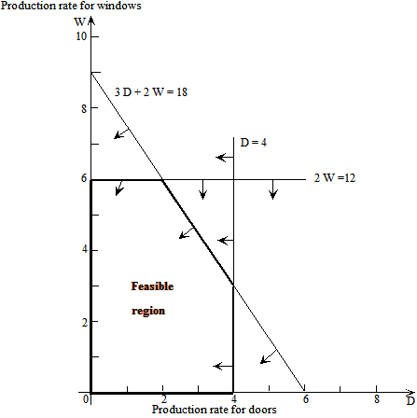
Introduction to Integer Programming
Decision Variables are Linear
Decision Variables are Integer

Slide 7
Outline
Introduction to Integer Programming
Basic Properties
Binary Integer Programming
Yes-No decisions
If, then, or constraints
Mixed-Integer Programming
Big M constraints
Solution Methods
Linear Relaxation
Branch-and-bound

Slide 8
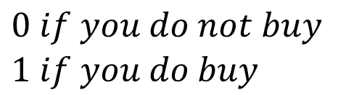
Binary Integer Programming
A special class of integer programming problems
Decision variables are binary
A binary decision variable can be 0 or 1
Generally used for Yes and No decisions
Suppose that your decision is to buy or not to buy a house
Let X be 0 if you decide not to buy the house
Let X be 1 if you decide to buy the house
X=
$$\begin{matrix}0 if you do not buy \\ 1 if you do buy \end{matrix}$$

Slide 9
Binary Integer Programming
California Manufacturing Co. Problem
The California Manufacturing Company is a diversified company with several factories and warehouses throughout California, but none yet in Los Angeles or San Francisco.
A basic issue is whether to build a new factory in Los Angeles or San Francisco, or perhaps even both.
Management is also considering building at most one new warehouse, but will restrict the choice to a city where a new factory is being built.

Slide 10
Binary Integer Programming
We are given the following data
Question: Should the California Manufacturing Company expand with factories and/or warehouses in Los Angeles and/or San Francisco?
Decision Number | Yes-or-No Question | Decision Variable | Net Present Value (Millions) | Capital Required (Millions)
1 | Build a factory in Los Angeles? | x₁ | $8 | $6
2 | Build a factory in San Francisco? | x₂ | 5 | 3
3 | Build a warehouse in Los Angeles? | x₃ | 6 | 5
4 | Build a warehouse in San Francisco? | x₄ | 4 | 2
 |  | Capital Available: $10 million

Slide 11
Binary Integer Programming
Defining the binary decision variables
Decision Number | Decision Variable | Possible Value | Interpretation of a Value of 1 | Interpretation of a Value of 0
1 | x₁ | 0 or 1 | Build a factory in Los Angeles | Do not build this factory
2 | x₂ | 0 or 1 | Build a factory in San Francisco | Do not build this factory
3 | x₃ | 0 or 1 | Build a warehouse in Los Angeles | Do not build this warehouse
4 | x₄ | 0 or 1 | Build a warehouse in San Francisco | Do not build this warehouse

Slide 12
Binary Integer Programming
Mathematical formulation:
Step 1: Decision Variables
x₁ = 1 if build a factory in L.A.; 0 otherwise
x₂ = 1 if build a factory in S.F.; 0 otherwise
x₃ = 1 if build a warehouse in L.A.; 0 otherwise
x₄ = 1 if build a warehouse in S.F.; 0 otherwise
Step 2: Objective and objective function
Maximize NPV = 8x₁ + 5x₂ + 6x₃ + 4x₄ ($millions)

Slide 13
Binary Integer Programming
Step 3: Constraints
Capital available
6x₁ + 3x₂ + 5x₃ + 2x₄ ≤ 10 ($millions)
Management is also considering building at most one new warehouse,
x₃ + x₄ ≤ 1
but will restrict the choice to a city where a new factory is being built
x₃ ≤ x₁ x₄ ≤ x₂
If x₁=0, then x₃=0
If x₁=1, then x₃=1 or x₃=0
If x₂=0, then x₄=0
If x₂=1, then x₄=1 or x₄=0

Slide 14
Binary Integer Programming
And the BIP model is
Maximize 8x₁ + 5x₂ + 6x₃ + 4x₄
Subject to 6x₁ + 3x₂ + 5x₃ + 2x₄ ≤ 10
x₃ + x₄ ≤ 1
x₃ ≤ x₁ x₄ ≤ x₂
x₁, x₂, x₃, x₄ are binary variables
x₁∈{0,1}, x₂∈{0,1}, x₃∈{0,1}, x₄∈{0,1}

Slide 15
Binary Integer Programming
Spreadsheet modeling

Slide 16
Binary Integer Programming
California Manufacturing Co. Problem
You have to open at least 1 factory (LA or SF factory should be opened)
x₁ +x₂ ≥ 1
You have to open at least 1 warehouse if you have opened two factories
If x₁ + x₂=2, then x₃ + x₄ ≥1
x₃ + x₄ ≥ x₁ +x₂ -1
x1 | x2 | x1+x2-1
0 | 0 | -1 | <= | x3+x4 | x3={0,1}, x4={0,1}
1 | 0 | 0 | <= | x3+x4 | x3={0,1}, x4={0,1}
0 | 1 | 0 | <= | x3+x4 | x3={0,1}, x4={0,1}
1 | 1 | 1 | <= | x3+x4 | x3=1 or x4=1

Slide 17
Binary Integer Programming
Project Selection at Tazer Corp.
Tazer Corporation is searching for a new breakthrough drug. Five potential research and development projects:
Project Up: Develop a more effect antidepressant that doesn’t cause mood swings
Project Stable: Develop a drug that addresses manic depression
Project Choice: Develop a less intrusive birth control method for women
Project Hope: Develop a vaccine to prevent HIV infection
Project Release: Develop a more effective drug to lower blood pressure
$1.2 billion available for investment

Slide 18
Binary Integer Programming
We are given the following data
 | 1 Up | 2 Stable | 3 Choice | 4 Hope | 5 Release
R&D ($million) | 400 | 300 | 600 | 500 | 200
Success Rate | 50% | 35% | 35% | 20% | 45%
Revenue if Successful ($million) | 1,400 | 1,200 | 2,200 | 3,000 | 600
Expected Profit ($million) | 300 | 120 | 170 | 100 | 70
Expected Profit = Success Rate X Revenue if successful – R&D Cost
Which projects should be selected to research and develop?

Slide 19
Binary Integer Programming
Let x_{i} = 1 if approve project i; 0 otherwise (for i = 1, 2, 3, 4, and 5)
Maximize P = 300x₁ + 120x₂ + 170x₃ + 100x₄ + 70x₅
Subject to 400x₁ + 300x₂ + 600x₃ + 500x₄ + 200x₅ ≤ 1,200
x_{i} are binary (for i = 1, 2, 3, 4, and 5).

Slide 20
Binary Integer Programming
Project Selection at Tazer Corp is a 0-1 knapsack problem
Knapsack Problem
There is a knapsack you can fill with a set of items
Each item has different benefit and different weight
The knapsack can carry limited weight
Surviving in an island example was a knapsack problem
0-1 Knapsack problem is NP-hard (hard to solve!!)
Pseduo polynomial algorithm exists

Slide 21
Binary Integer Programming
Sometimes, it might be the case that you do not have binary decision variables explicitly, but you have to define them
Consider the linear Wyndor Class Co. problem
If you produce doors, you have to produce at least 3
If D>0 then D>=3
Define y=0 if we do not produce doors, y=1 if we produce doors
Then, D>=3y, is this sufficient?
If y=1, then D>=3, so that is nice, but if y=0, D>=0; however, D should be 0 when y=0, therefore, we need to add the following
Also add D<=My, where M is a large number
If y=1, then D<=M, which is true, but if y=0, D<=0, i.e., D=0

Slide 22
Binary Integer Programming
The Caliente City Problem
Caliente City is growing rapidly and spreading well beyond its original borders
They still have only one fire station, located in the congested center of town
The result has been long delays in fire trucks reaching the outer part of the city
Goal: Develop a plan for locating multiple fire stations throughout the city to minimize costs
New Policy: Response Time ≤ 10 minutes

Slide 23
Binary Integer Programming
We are given the following data
 |  | Fire Station in Tract
 |  | 1 | 2 | 3 | 4 | 5 | 6 | 7 | 8
Response times (minutes) for a fire in tract | 1 | 2 | 8 | 18 | 9 | 23 | 22 | 16 | 28
 | 2 | 9 | 3 | 10 | 12 | 16 | 14 | 21 | 25
 | 3 | 17 | 8 | 4 | 20 | 21 | 8 | 22 | 17
 | 4 | 10 | 13 | 19 | 2 | 18 | 21 | 6 | 12
 | 5 | 21 | 12 | 16 | 13 | 5 | 11 | 9 | 12
 | 6 | 25 | 15 | 7 | 21 | 15 | 3 | 14 | 8
 | 7 | 14 | 22 | 18 | 7 | 13 | 15 | 2 | 9
 | 8 | 30 | 24 | 15 | 14 | 17 | 9 | 8 | 3
Cost of Station ($thousands) |  | 350 | 250 | 450 | 300 | 50 | 400 | 300 | 200

Slide 24

Binary Integer Programming
Mathematical formulation
Let x_{j} = 1 if tract j is selected to receive a fire station; 0 otherwise (j = 1, 2, … , 8)
Minimize 350x₁ + 250x₂ + 450x₃ + 300x₄ + 50x₅ + 400x₆ + 300x₇ + 200x₈
subject to x₁ + x₂ + x₄ ≥ 1
x₁ + x₂ + x₃ ≥ 1
x₂ + x₃ + x₆ ≥ 1
x₁ + x₄ + x₇ ≥ 1
x₅ + x₇ ≥ 1
x₃ + x₆ + x₈ ≥ 1
x₄ + x₇ + x₈ ≥ 1
x₆ + x₇ + x₈ ≥ 1
x_{j} are binary (for j = 1, 2, … , 8).

Slide 25
Binary Integer Programming
Spreadsheet modeling

Slide 26
Binary Integer Programming
Southwestern Airways Crew Scheduling
Southwestern Airways needs to assign crews to cover all its upcoming flights.
We will focus on assigning 3 crews based in San Francisco (SFO) to 11 flights.
Question: How should the 3 crews be assigned 3 sequences of flights so that every one of the 11 flights is covered?

Slide 27
Binary Integer Programming

Slide 28
Binary Integer Programming
We are given the following data
 | Feasible Sequence of Flights
Flights | 1 | 2 | 3 | 4 | 5 | 6 | 7 | 8 | 9 | 10 | 11 | 12
1. SFO–LAX | 1 |  |  | 1 |  |  | 1 |  |  | 1
2. SFO–DEN |  | 1 |  |  | 1 |  |  | 1 |  |  | 1
3. SFO–SEA |  |  | 1 |  |  | 1 |  |  | 1 |  |  | 1
4. LAX–ORD |  |  |  | 2 |  |  | 2 |  | 3 | 2 |  | 3
5. LAX–SFO | 2 |  |  |  |  | 3 |  |  |  | 5 | 5
6. ORD–DEN |  |  |  | 3 | 3 |  |  |  | 4
7. ORD–SEA |  |  |  |  |  |  | 3 | 3 |  | 3 | 3 | 4
8. DEN–SFO |  | 2 |  | 4 | 4 |  |  |  | 5
9. DEN–ORD |  |  |  |  | 2 |  |  | 2 |  |  | 2
10. SEA–SFO |  |  | 2 |  |  |  | 4 | 4 |  |  |  | 5
11. SEA–LAX |  |  |  |  |  | 2 |  |  | 2 | 4 | 4 | 2
Cost, $1,000s | 2 | 3 | 4 | 6 | 7 | 5 | 7 | 8 | 9 | 9 | 8 | 9
Flight 2 then 9 then 6 then 8

Slide 29
Binary Integer Programming
Mathematical formulation
Let x_{j} = 1 if flight sequence j is assigned to a crew; 0 otherwise. (j = 1, 2, … , 12).
We are minimizing total cost
Minimize Cost = 2x₁ + 3x₂ + 4x₃ + 6x₄ + 7x₅ + 5x₆ + 7x₇ + 8x₈ + 9x₉ + 9x₁₀ + 8x₁₁ + 9x₁₂
We have at most three crews to assign
x₁ + x₂ + x₃ + x₄ + x₅ + x₆ + x₇ + x₈ + x₉ + x₁₀ + x₁₁ + x₁₂ ≤ 3

Slide 30
Binary Integer Programming
Mathematical formulation continues…
Each flight has to be covered
Sequences 1, 4, 7, 10 cover flight 1
So at least one of these sequences should be selected
x₁ + x₄ + x₇ + x₁₀ ≥ 1 Flight 1 covered
Sequences 2, 5, 8, 11 cover flight 2
So at least one of these sequences should be selected
x₂ + x₅ + x₈ + x₁₁ ≥ 1 Flight 2 is covered

Slide 31
Binary Integer Programming
Minimize Cost = 2x₁ + 3x₂ + 4x₃ + 6x₄ + 7x₅ + 5x₆ + 7x₇ + 8x₈ + 9x₉ + 9x₁₀ + 8x₁₁ + 9x₁₂ subject to Flight 1 covered: x₁ + x₄ + x₇ + x₁₀ ≥ 1 Flight 2 covered: x₂ + x₅ + x₈ + x₁₁ ≥ 1 : : Flight 11 covered: x₆ + x₉ + x₁₀ + x₁₁ + x₁₂ ≥ 1 Three Crews: x₁ + x₂ + x₃ + x₄ + x₅ + x₆ + x₇ + x₈ + x₉ + x₁₀ + x₁₁ + x₁₂ ≤ 3 and x_{j} are binary (j = 1, 2, … , 12).

Slide 32
Binary Integer Programming
Spreadsheet model

Slide 33
Binary Integer Programming
If sequences 1, 2, 3 are all selected, then 4 cannot be selected
x₁ + x₂ + x₃ + x₄ ≤ 3
If sequence 5 is selected, 6 cannot be selected
x₅ + x₆ ≤ 1
If 10 is selected, 11 has to be selected
x₁₁ ≥ x₁₀

Slide 34
Outline
Introduction to Integer Programming
Basic Properties
Binary Integer Programming
Yes-No decisions
If, then, or constraints
Mixed-Integer Programming
Big M constraints
Solution Methods
Linear Relaxation
Branch-and-bound

Slide 35
Mixed-Integer Programming
When you have both integer and continuous decision variables
Wyndor Problem with Setup Costs
For each product, producing any units requires a substantial one-time setup cost for setting up the production facilities
The production runs for these products will be ended after one week, so D and W in the original model now represent the total number of doors and windows produced, respectively, rather than production rates.

Slide 36
Mixed-Integer Programming
Solution for the original problem

Slide 37
Mixed-Integer Programming
Profits with setup costs
 | Net Profit ($)
Number of Units Produced | Doors | Windows
0 | 0(300) – 0 = 0 | 0 (500) – 0 = 0
1 | 1(300) – 700 = –400 | 1(500) – 1,300 = –800
2 | 2(300) – 700 = –100 | 2(500) – 1,300 = –300
3 | 3(300) – 700 = 200 | 3(500) – 1,300 = 200
4 | 4(300) – 700 = 500 | 4(500) – 1,300 = 700
5 | Not feasible | 5(500) – 1,300 = 1,200
6 | Not feasible | 6(500) – 1,300 = 1,700

Slide 38
Mixed-Integer Programming

Slide 39
Mixed-Integer Programming
Mathematical formulation
D = Number of doors to produce,
W = Number of windows to produce,
y₁ = 1 if perform setup to produce doors; 0 otherwise,
y₂ = 1 if perform setup to produce windows; 0 otherwise
Maximize P = 300D + 500W – 700y₁ – 1,300y₂ subject to D ≤ 4 (Plant 1 availability) 2W ≤ 12 (Plant 2 availability)
3D + 2W ≤ 18 (Plant 3 availability)
D ≤ 99y₁ (Produce only if you setup for it) W ≤ 99y₂ (Produce only if you setup for it) D ≥ 0, W ≥ 0, y₁ and y₂ are binary.
Just a large number

Slide 40
Mixed-Integer Programming
Consider the following constraint:
If you produce doors, you have to produce at least 3
D>= 3? Would work?
No, because D can be 0 too
How about
D>=3y₁
D<=My₁

Slide 41
Mixed-Integer Programming
Integrated facility location – transportation
Suppose you have n customers, indexed by i=1,2,…,n
Customer i has a demand of Di
You can locate warehouses at m locations, indexed by j=1,2,…,m
Building a warehouse at location j costs you fj
You can build at most 1 warehouse at any location j with unlimited capacity
Shipping from location j to customer i costs you cij
Where you should build warehouses and how you should ship to your customers to minimize costs?

Slide 42
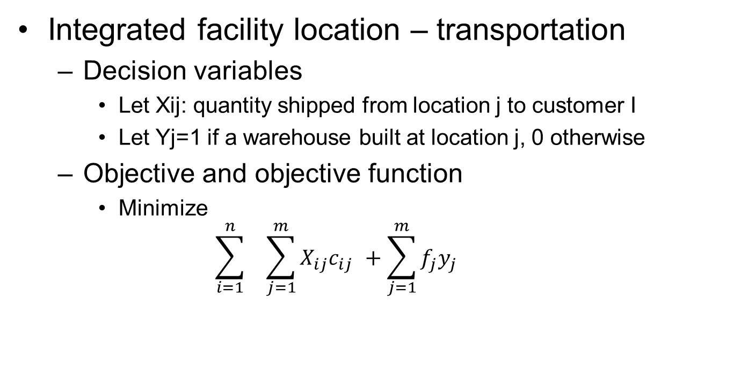
Mixed-Integer Programming
Integrated facility location – transportation
Decision variables
Let Xij: quantity shipped from location j to customer I
Let Yj=1 if a warehouse built at location j, 0 otherwise
Objective and objective function
Minimize
$$\sum_{i=1}^{n}{ } _{ }\sum_{j=1}^{m}{{X_{ij}c}_{ij _{ }}+\sum_{j=1}^{m}{f_{j}{y_{j}}_{ }}}$$

Slide 43
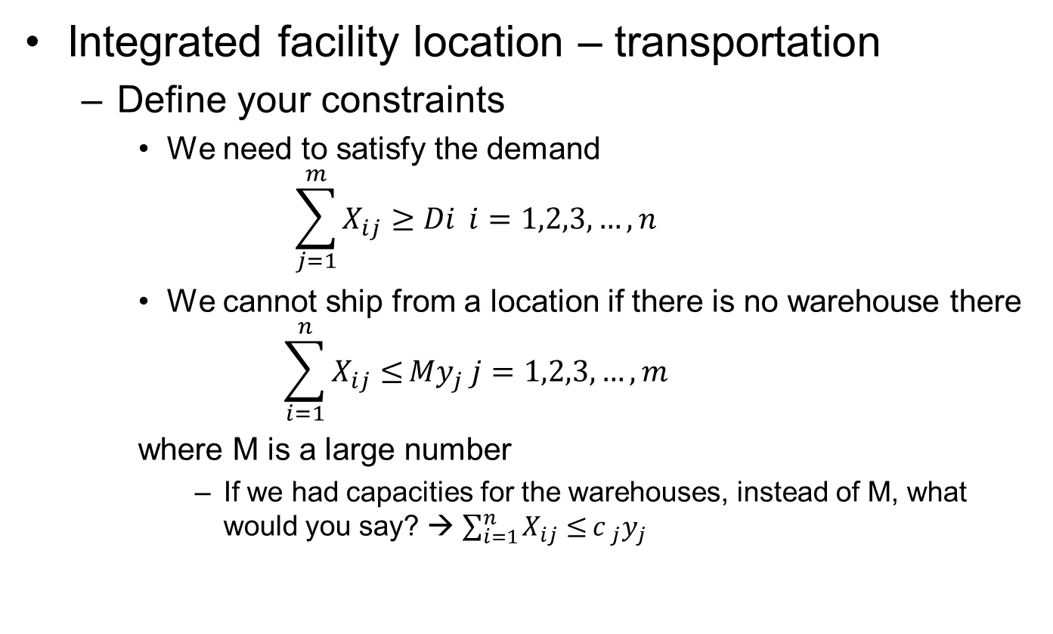
Mixed-Integer Programming
Integrated facility location – transportation
Define your constraints
We need to satisfy the demand
$$\sum_{j=1}^{m}{X_{ij}≥Di} i=1,2,3,…,n$$
We cannot ship from a location if there is no warehouse there
$$\sum_{i=1}^{n}{X_{ij}≤}{My}_{j} j=1,2,3,…,m$$
where M is a large number
If we had capacities for the warehouses, instead of M, what would you say? → $\sum_{i=1}^{n}{X_{ij}≤}{c _{j}y}_{j}$

Slide 44
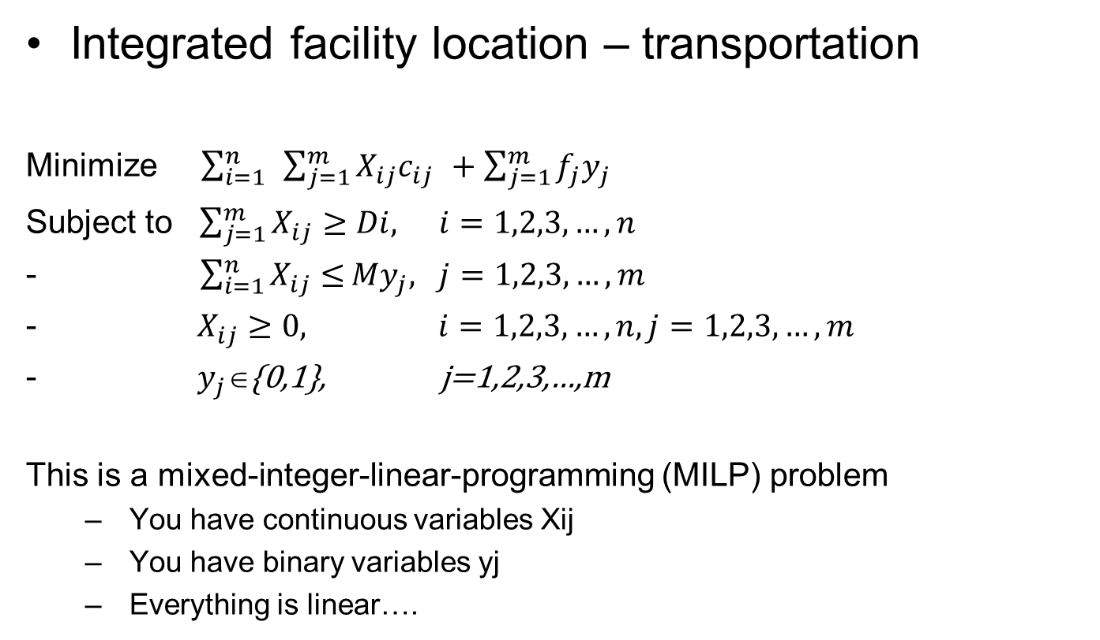
Mixed-Integer Programming
Integrated facility location – transportation
Minimize $\sum_{i=1}^{n}{ }\sum_{j=1}^{m}{{X_{ij}c}_{ij _{ }}+\sum_{j=1}^{m}{f_{j}{y_{j}}_{ }}}$
Subject to $\sum_{j=1}^{m}{X_{ij}≥Di,} i=1,2,3,…,n$
- $\sum_{i=1}^{n}{X_{ij}≤}{My}_{j}, j=1,2,3,…,m$
$X_{ij}≥0, i=1,2,3,…,n,j=1,2,3,…,m$
$y_{j}\text{∈}${0,1}, j=1,2,3,…,m
This is a mixed-integer-linear-programming (MILP) problem
You have continuous variables Xij
You have binary variables yj
Everything is linear….

Slide 45
Outline
Introduction to Integer Programming
Basic Properties
Binary Integer Programming
Yes-No decisions
If, then, or constraints
Mixed-Integer Programming
Big M constraints
Solution Methods
Linear Relaxation
Branch-and-bound

Slide 46
Solution Methods
Integer programming problems are harder to solve compared to the Linear programming problems
Basically, IPs do not have the corner solution property
When we draw the constraint lines, the corner points can be non-integer

Slide 47
Solution Methods
Maximize 300D+500W
subject to D ≤ 4
2W ≤ 12
3D+2W ≤ 18
D≥0, W ≥0
D integer
W integer
Maximize 300D+500W
subject to D ≤ 4
2W ≤ 12
3D+2W ≤ 18
D≥0, W ≥0
Its linear relaxation
Integer programming model
Linear relaxation provides better results
If the optimal solution of linear relaxation is integer, then we know the optimal solution to the integer programming model as well!!!

Slide 48
Solution Methods
Branch and Bound Algorithm
Suppose we have an IP problem
We solve its Linear Relaxation (relatively easy)
Solution to the Linear Relaxation is integer
Then we know what we have the optimum for our IP
Solution to the Linear Relaxation is fractional
Suppose in the optimum solution, x1=1.5
We know that we can have x1<=1 or x1>=2
So, let’s solve two different problems by adding these as constraints in each

Slide 49
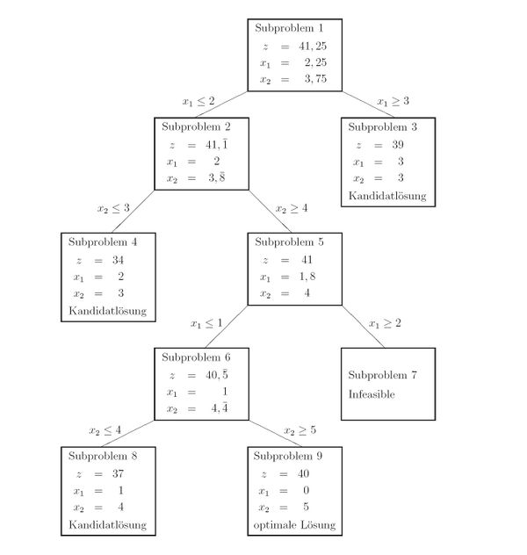
Solution Methods
Solution is fractional
Branch on x1
Solution is fractional
Solution is integer…
No need to continue branching…This is a candidate optimum
Branch on x2
Solution is integer…
No need to continue branching…This is another candidate optimum
Solution is fractional
Branch on x1
Infeasible, so we should not continue branching, as it will again be infeasible

Slide 50
Solution Methods
Stop branching a node (fathoming)
If that node’s optimal solution is integer
Because if we continue, we will not get any better solution, since branching is adding constraints… and we know adding constraints cannot improve our solution
If that node is infeasible
Because if we continue, we will get infeasible subproblems
If that node is fractional and the optimal objective function value is worse than our best integer solution
Because, if we continue we know that we will not get a better solution, hence, we will not get a better integer solution
We already have an integer solution that is better, so, we do not need to continue

Slide 51
Further study…
Read Chapter 7…
Practice problems
7.2, 7.3, 7.5, 7.6, 7.7, 7.13, 7.14, 7.16
Practice case:
Cases of Chapter 7

